Slide 1
Flying and Judging F3A
SCHEMATIC MANOEUVRE ILLUSTRATIONS
SCHEDULE A-27

Slide 2
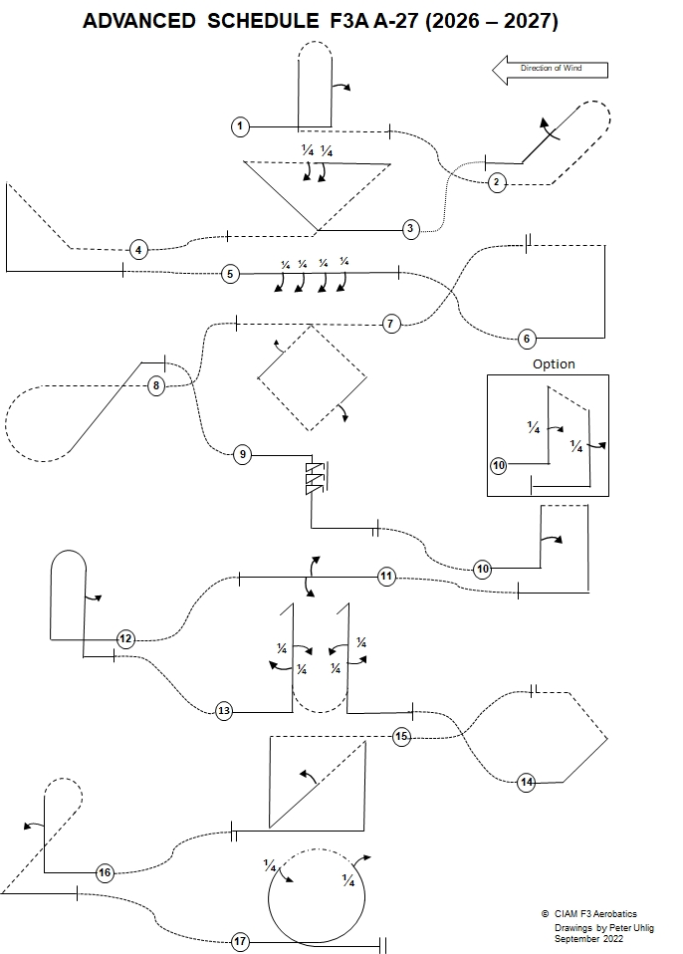
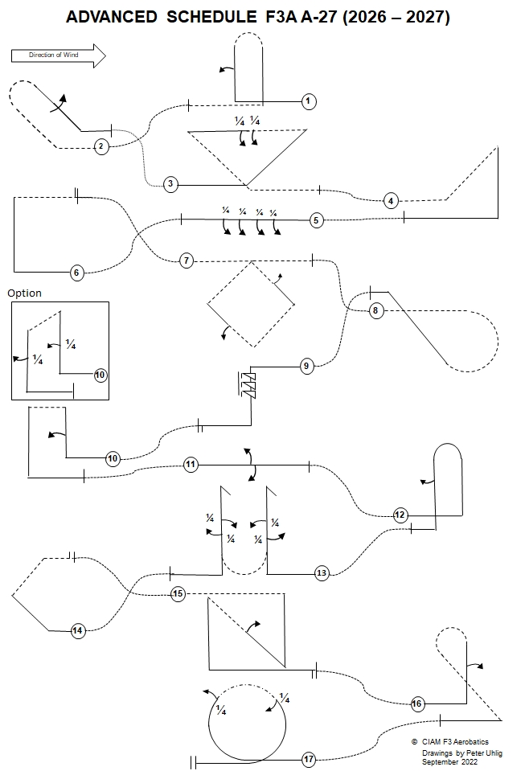

Slide 3
Explanations:
Aircraft upright
Aircraft inverted
Aircraft in Knife-Edge View from Top
Aircraft in Knife-Edge View from Below
part roll
half roll
roll
¼
pos. spin
neg. spin
snap rolls
pos.
neg.
reference points

Slide 4
Take-off procedure
( not judged, not scored )
wind
120⁰
Safety line

Slide 5
A-27.01 Pull-Push-Push Humpty Bump with half roll
½ roll
From upright, at centre, pull through a quarter loop into a vertical upline, perform a ½ roll, push through a half loop into a vertical downline, push through a ¼ loop, exit inverted
A-27.01.01

Slide 6
A-27.01 Pull-Push-Push Humpty Bump with half roll
Half roll on middle of the line.
All radii are equal.
A-27.01.02

Slide 7
A-27.02 Trombone with roll
roll
From inverted, push through a ⅛ loop into a 45° upline, push through a half loop into a 45° downline, perform a roll, pull through a ⅛ loop, exit upright.
A-27.02.01

Slide 8
A-27.02 Trombone with roll
Roll on middle of the line.
All radii are equal.
45°
A-27.02.02

Slide 9
A-27.03 Triangle with quarter roll, quarter roll
¼ roll
¼ roll
From upright, at centre, pull through a ⅛ loop into a 45° upline, pull through a ⅜ loop, perform consecutively two ¼ rolls, push through a ⅜ loop into a 45° downline, push through ⅛ loop, exit inverted.
A-27.03.01

Slide 10
A-27.03 Triangle with quarter roll, quarter roll
Part rolls centered on middle of the line.
¼
¼
Lines between part rolls must be short and of recognisable length.
All radii are equal.
45°
A-27.03.02

Slide 11
A-27.04 Reverse Shark Fin
From inverted, push through a ⅛ loop into a 45°upline, pull through a ⅜ loop into a vertical downline, pull through a ¼ loop, exit upright.
A-27.04.01

Slide 12
A-27.04 Reverse Shark Fin
All radii are equal.
A-27.04.02

Slide 13
A-27.05 Four consecutive quarter rolls
¼
roll
¼
roll
¼
roll
¼
roll
From upright, perform consecutively four ¼ rolls, exit upright.
A-27.05.01

Slide 14
A-27.05 Four consecutive quarter rolls
Lines between part rolls must be short
and of equal length.
¼
¼
¼
¼
A-27.05.02

Slide 15
A-27.06 Half Square Loop
From upright, pull through a quarter loop into a vertical upline, pull through a quarter
loop, exit inverted.
A-25.06.01

Slide 16
A-27.06 Half Square Loop
All radii are equal.
A-25.06.02

Slide 17
A-27.07 Square Loop on Corner from Top with half roll, half roll
½ roll
½ roll
From inverted, pull through a ⅛ loop into a 45° downline, perform a ½ roll, push through a ¼ loop into a 45° downline, push through a ¼ loop into a 45° upline, perform a ½ roll, pull through a ¼ loop into a 45° upline, pull through a ⅛ loop, exit inverted.
A-27.07.01

Slide 18
A-27.07 Square Loop on corner from Top with half roll,
half roll
½ rolls on middle of the line.
45°
All radii are equal.
A-27.07.02

Slide 19
A-27.08 Half Cuban Eight from Top
From inverted, pull through a ⅝ loop into a 45° upline, push through a ⅛ loop, exit upright.
A-27.08.01

Slide 20
A-27.08 Half Cuban Eight from Top
All radii are equal.
A-27.08.02

Slide 21
A-27.09 Spin with three turns
From upright, perform a spin with three turns, perform a vertical downline, pull through a ¼ loop, exit upright.
A-27.09.01

Slide 22
A-27.09 Spin with three turns
Snap entry - 0 points!
Spiral dive - 0 points!
Forced entry: downgrade.
Line after the spins.
A-27.09.02

Slide 23
A-27.10 Top Hat with half roll. Option: Top Hat with
quarter roll, quarter roll
½ roll
From upright, pull through a ¼ loop into a vertical upline, perform a ½ roll, pull through a ¼ loop, pull through a ¼ loop into a vertical downline, pull through ¼ loop, exit upright.
A-27.10.01

Slide 24
A-27.10 Top Hat with half roll. Option: Top Hat with
quarter roll, quarter roll
½ roll on middle of the line.
All radii are equal.
A-27.10.02

Slide 25
A-27.10 Top Hat with half roll. Option: Top Hat with
quarter roll, quarter roll
Option
¼ roll
¼ roll
Option: From upright, pull through a ¼ loop into a vertical upline, perform a ¼ roll, pull through a ¼ loop into a cross box line, pull through a ¼ loop into a vertical downline, perform a ¼ roll, pull through ¼ loop, exit upright.
A-27.10.03

Slide 26
A-27.10 Top Hat with half roll. Option: Top Hat with
quarter roll, quarter roll
Option
Part rolls on middle of the line.
¼
All radii are equal.
¼
A-27.10.04

Slide 27
A-27.11 Two consecutive half rolls
½
roll
½
roll
From upright perform consecutively two ½ rolls in opposite direction, exit upright.
A-27.11.01

Slide 28
A-27.11 Two consecutive half rolls
Between rolls and part rolls in opposite direction there must be no line.
A-27.11.02

Slide 29
A-27.12 Pull-Pull-Pull Humpty Bump with half roll
½ roll
From upright, pull through a ¼ loop into a vertical upline, pull through a half loop into a vertical downline, perform a half roll, pull through a ¼ loop, exit upright.
A-27.12.01

Slide 30
A-27.12 Pull-Pull-Pull Humpty Bump with half roll
½ roll on middle of the line.
All radii are equal.
A-2712.02

Slide 31
A-27.13 Figure M with quarter roll, quarter roll, quarter roll, quarter roll
¼ roll
¼ roll
¼ roll
¼ roll
From upright, before centre, pull through a ¼ loop into a vertical upline, perform a ¼ roll, perform a stall turn into a vertical downline, perform a ¼ roll, push through a half loop into a vertical upline, perform a ¼ roll, perform a stall turn into a vertical downline, perform a ¼ roll, pull through a ¼ loop, exit upright.
A-27.13.01

Slide 32
A-27.13 Figure M with quarter roll, quarter roll, quarter roll, quarter roll
Pivot
on CG
Stop before pivot
Two wing spans or more – zero points!
Part rolls on middle of the lines.
¼
¼
¼
¼
All radii are equal.
A-27.13.02

Slide 33
A-27.14 Half Square Loop on Corner
From upright, pull through a ⅛ loop into a 45° upline, pull through a ¼ loop into a 45° upline, pull through a ⅛ loop, exit inverted.
A-27.14.01

Slide 34
A-27.14 Half Square Loop on Corner
All radii are equal.
45°
A-27.14.02

Slide 35
A-27.15 Square from Top with half roll
½ roll
From inverted, fly past centre, pull through a ¼ loop into a vertical downline, pull through a ⅜ loop into a 45° upline, perform a ½ roll, pull through a ⅜ loop into a vertical downline, pull through a ¼ loop, exit upright.
A-27.15.01

Slide 36
A-27.15 Square from Top with half roll
Half roll on middle of the 45° line.
All radii are equal.
45°
A-27.15.02

Slide 37
A-27.16 Reverse Figure ET with half roll
½ roll
From upright, pull through ¼ loop into a vertical upline, perform a ½ roll, push through a ⅝ loop into a 45° downline, pull through a ⅜ loop, exit upright.
A-27.16.01

Slide 38
A-27.16 Reverse Figure ET with half roll
½ roll on middle of the line.
45°
All radii are equal.
A-25.16.02

Slide 39
A-27.17 Loop with knife-edge flight
¼ roll
45°
¼ roll
From upright, pull through a loop, perform a ¼ roll into a knife-edge flight over top 90° of the loop, perform a ¼ roll, exit upright.
A-27.17.01

Slide 40
A-27.17 Loop with knife-edge flight
¼
45°
¼
90°
During knife.edge wing must be in the vertical plane
Loop must be round.
A-27.17.01

Slide 41
Landing procedure
( not judged, not scored )
The direction of the landing may be different to the take off.
wind
120⁰
Safety line

Slide 42
Forget WHO is flying
(friend, rival, countryman, flier from other nation)
Forget WHAT is flying
(2-stroke, 4-stroke, electric)
LOOK ONLY AT LINES DESCRIBED IN THE SKY!
Bob Skinner
Thank you!
© Peter Uhlig, September 2025

